Slide 1
I/1. Basics of Python
Data Analyst Intermediate – PYTHON-based Data Analysis, Data Cleaning, Data Visualization & Predictions
Data Analyst Intermediate
Trainer: Szabolcs Jobbagy

Slide 2




Installing the Anaconda Navigator
Download the desktop application called Anaconda Navigator, in which we can program in several programming languages using a Graphical User Interface (GUI)
https://www.anaconda.com
When the Anaconda installer (.EXE) was downloaded, run it, and click through the installation with the default settings
After installation is done, open Anaconda Navigator

Slide 3
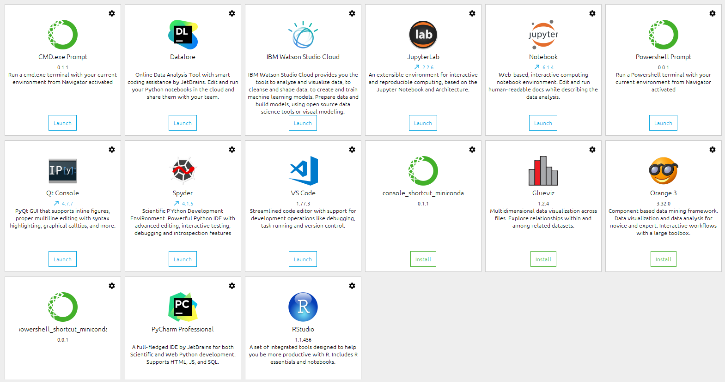
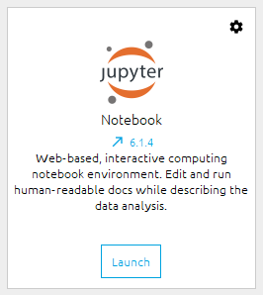
Launching the Jupyter Notebook
When you open Anaconda Navigator, you will see different integrated development environments (IDE) where we can code in several languages like Python and "R" language
We can do Data Science, Machine Learning and other projects in user-friendly, convenient environments, hundreds of useful packages are already installed, and thousands of other packages can be added easily
Launch the Jupyter Notebook development environment (press Launch button)

Slide 4
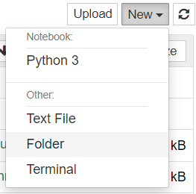

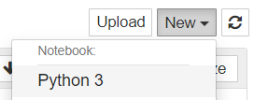



Input modes
Create a new folder: New - Folder
Start a notebook: New – Notebook (Python 3)
"Edit" mode (ENTER): here we can enter/modify the code v. text in the cells (the cell will have a GREEN frame and a GREEN left margin)
"Command" mode (ESC): the keyboard can now give notebook-level commands (the cell will have a GRAY frame and a BLUE left margin)
You can use the up/down arrows to move
between program lines in "Edit" mode, and
between cells in "Command" mode
Run the cell: CTRL + ENTER
Insert a new cell above cell: A
Insert a new cell below cell: B

Slide 5





Spelling of Python code
Comments: Start the line with #
With symbols, it doesn't matter if we write a space or not: a=6 or a = 6, but the code will be more readable if we use spaces
Texts can also be enclosed in apostrophes / single quotes (') or quotation marks / double quotes (")
If you type an opening (any) parenthesis/brackets, apostrophe or quotation mark, the closing one is automatically entered: () [] {} ' ' " "
Almost everything can be written in lowercase, so programming is faster and easier
It's recommended to write the names of the variables in lowercase letters and without accents, there can be no SPACE, but an underscore (_) can be used (e.g. birth_date)

Slide 6
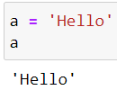



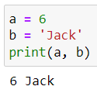
Writing out, showing data
If you want to write out any data/variable, just type/copy its name into a separate program line and run cell (Ctrl+Enter)
Data can also be printed with the print command, but it must be enclosed in round brackets
Multiple data can be listed separated by commas

Slide 7
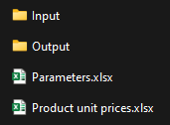
The correct spelling of folders, file paths
In the path of the files, a double backslash should be used instead of a plain backslash
Add the folder path where your downloaded course files are
If you want to use the plain, single backslash, put an r at the very beginning:
basepath = 'D:\\Trainings\\Cubix\\Python_DA'
basepath = r'D:\Trainings\Cubix\Python_DA'

Slide 8

Accessing folder contents – The OS module
The "OS" module: interactions with the operating system (creating/deleting folders, reading the contents of folders etc.)
Modules can be "called" into the code like this: import ……
os.listdir(folder): listing the files of the folder
os.getcwd(): get the current working directory (where this program/notebook is)
# import the os module to access the operating system import os
# the file list of folder os.listdir(basepath)
# the file list of folder os.listdir(basepath + '\\input')
# get the current working directory current_workingdir = os.getcwd() current_workingdir

Slide 9



Floor division, remainder
//: gives the quotient (result of a division) rounded down to integer (floor division)
%: gives the remainder (modulus) of a division
divmod(number, divisor): gives the floor division quotient and the remainder (modulus)
a = 203 b = 11 # a / b floor division quotient a // b
a = 203 b = 11 # remainder of a / b a % b
# floor division quotient and the remainder floor_quotient, remainder = divmod(203, 11) print(floor_quotient) print(remainder)

Slide 10


Exponentiation, roots
a ** b: exponentiation, a^{b}
pow(a, b): exponentiation, a^{b}
Roots: exponentiation with reciprocal, a^{1/b}
a = 2 b = 5 # exponentiation (power) a ** b
a = 2 b = 5 # exponentiation (power) pow(a, b)
a = 64 b = 2 # root a ** (1 / b)

Slide 11

Main data types of variables
We can store data in the memory in Variables to work with them faster
type(variable): data type of variable
str: text (string)
int: integer number
float: floating-point number (integer / fraction)
name = 'Jack' age = 20 weight = 83.5 # show data type of variables print(type(name)) print(type(age)) print(type(weight))

Slide 12
I/2. Cleaning and Transforming text strings
Data Analyst Intermediate – PYTHON-based Data Analysis, Data Cleaning, Data Visualization & Predictions
Data Analyst Intermediate
Trainer: Szabolcs Jobbagy

Slide 13




Converting to uppercase, lowercase
Start a new notebook
string.upper(): convert text to upper case
string.lower(): convert text to lower case
string.title(): capitalize each word of text
a = 'Jack Bauer' # convert to upper case a.upper()
a = 'Jack Bauer' # convert to lower case a.lower()
a = 'jack Bauer' # capitalize each word a.title()

Slide 14

Removing unnecessary spaces
string.strip(): removes spaces before and after the text
It does not remove unnecessary spaces between words)
# removes spaces before and after the text a = ' aa bb ' a.strip()

Slide 15


Replacing string parts
string.replace(old, new): replace old text to new text
a = 'Jack Bauer' # replace old text to new text a = a.replace('Jack', 'John') a
# replace double spaces to single space a = ' aa bb ' a.replace(' ', ' ')

Slide 16




Searching for text (contains)
string.find(substring): starting position of substring from the left (0 = first character's index)
It is case sensitive
If text doesn't contain substring, the result is: -1
s = 'Anaconda' # starting position of substring from the left s.find('Ana')
s = 'Anaconda' # starting position of substring from the left s.find('ana')
s = 'Anaconda' # starting position of substring from the left s.find('con')
INDEX: 0 1 2 3 4 5 6 7

Slide 17


Searching for text (starts or ends with)
string.startswith(substring): whether the string starts with the substring
string.endswith(substring): whether the string ends with the substring
a = 'Jack Bauer' # whether the string starts with the substring a.startswith('Jack')
a = 'Jack Bauer' # whether the string ends with the substring a.endswith('Jack')

Slide 18







Slicing strings (left, middle, right) 1.
We can "cut", slice any part of the texts (index starts from 0)
Index endpoints are NOT included
s = 'Anaconda' # character at index 3 s[3]
# from the beginning until index 3 (endpoint not included) s[ : 4]
# from index 3 until the end s[3 : ]
# the last 3 characters s[-3 : ]
# from index 3 to index 5 (endpoint not included) s[3 : 6]
# from index 3 to index 8, every 2nd character s[3 : 9 : 2]
# full string reversed s[ : : -1]
# from index 8 backwards, every 2nd character s[8 : : -2]

Slide 19


Slicing strings (left, middle, right) 2.
We can use variables in slicing as well
len(string): the length of the string (number of characters)
If a text contains an apostrophe (single quote: ' ), we cannot put it between apostrophes, use quotation marks (double quotes: " ) instead, and vice versa
substring = 'language' mainstring = "Python is a cool programming language, isn't it?"
# length of text substring_length = len(substring)
substring_start = mainstring.find(substring) substring_end = substring_start + substring_length print(substring_start, substring_end)
# part of text between two positions (endpoint not included) sliced_part = mainstring[ substring_start : substring_end ] sliced_part

Slide 20



Splitting texts
string.split: Split text along a given (even multiple-character) separator
If no separator is given, it will be SPACE (and if there are more spaces, it will ignore them)
a = '12-15-20' # split text by separator a.split('-')
a = 'Jack Bauer' # split text by space a.split()
a = ' aa bb ' # split text by space (extra spaces ignored) a.split()

Slide 21




Concatenating texts
Text data can be concatenated with the + sign
If we want to concatenate also a number with the + sign, we should convert it to text: str(number)
At print, separating them by a comma, they don't need to be converted (and there will be a space between them)
separator.join(list): after splitting, we can concatenate them (we can solve the full trimming of extra spaces with this)
a = 'Jack' b = 'Bauer' a + ' ' + b
a = 'Number of files found: ' b = 6 a + str(b)
print(a, b)
a = ' aa bb ' # split text by space (extra spaces ignored) wordlist = a.split() # concatenate texts by separator ' '.join(wordlist)

Slide 22



Formatting strings with curly braces
string.format(variable1, variable2, …): we can insert values of variables into positions, "slots" of text: {} short version: f'……'
With a colon (:) we can format the values as well
a = 'Jack' b = 36 # insert values of variables into positions of text text = 'My name is {}, I am {} years old.'.format(a, b)
a = 35.567 # format number rounded to integer text = 'The temperature is {:.0f} degrees.'.format(a)
a = 19 # format number rounded to 2 decimals text = 'The price is {:.2f} dollars.'.format(a)
a = 0.5 # format number rounded to integer percentage text = 'This has {:.0%} probability.'.format(a)
a = 'Jack' b = 36 # insert values of variables into positions of text text = f'My name is {a}, I am {b} years old.'
# insert values of variables into positions of text text = f'My name is {a.upper()}, I am {b:.2f} years old.'

Slide 23

Usage of the backslash
If a text string is too long, we write the backslash \ character at the end, and we can continue \ the string on the next line
There are special \... characters:
\n: line break
\t: TAB (tabulator)
\': prints an apostrophe (within apostrophes)
\": prints quotation marks (within quotation marks)
\\: backslash in path
text = 'If a text string is too long, we write the backslash \ character at the end, and we can continue \ the string on the next line'
filesfound = 35 text = 'I have found\n{} files in the folder!'.format(filesfound) print(text)
missingfile = 'Data.csv' text = 'The file \"{}\" is missing from the folder!'.format(missingfile) print(text)

